Slide 1
Student Pics
Filmic Techniques

Slide 2
Can you guess the technique that student directors tried to capture in their images?

Slide 3
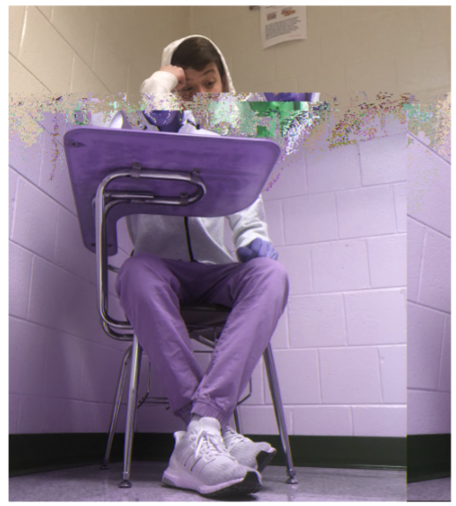
1.

Slide 4
2.

Slide 5
3.

Slide 6
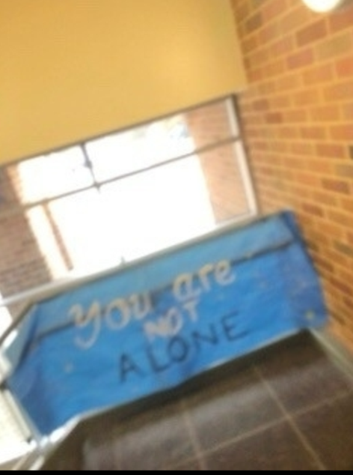
4.

Slide 7
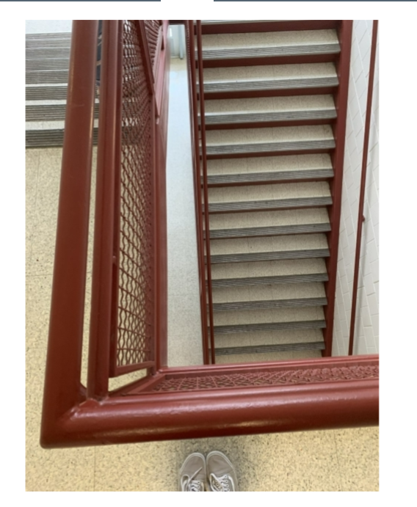
5.

